Slide 1
ARDUINO VISITOR COUNTER PROJECT
TEAM ELECTROSTARS PRESENTS

Slide 2

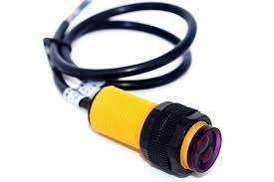
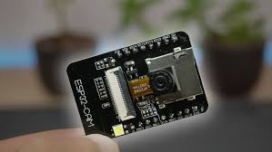
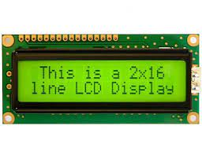
COMPONENTS OF THIS DEVICE
AURDINO UNO
1
2
IR SENSOR
CAMERA MODULE
1
1
BREADBOARD
1
LCD DISPLAY

Slide 3
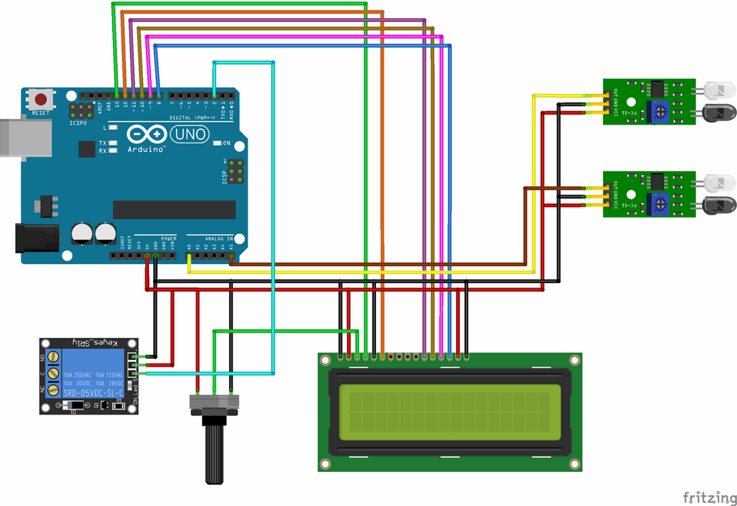

What Is This Device ??

Slide 4

INTRODUCTION
The purpose of this system is to detect whether a person is entering or leaving the room.
Hence display total number of person in a room at that particular instant.
Face detection counts number of people in front of door = count
If they enter the room -> total inside + face_count
If they leave the room -> total inside – face_count

Slide 5


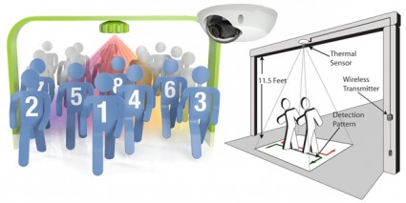
OBJECTIVE
With the help of this system we can find out number of persons in a confined area at a particular time.
Hence this can be used as a security system.
Also be helpful in maintaining crowd.
Automatic lights in houses.

Slide 6
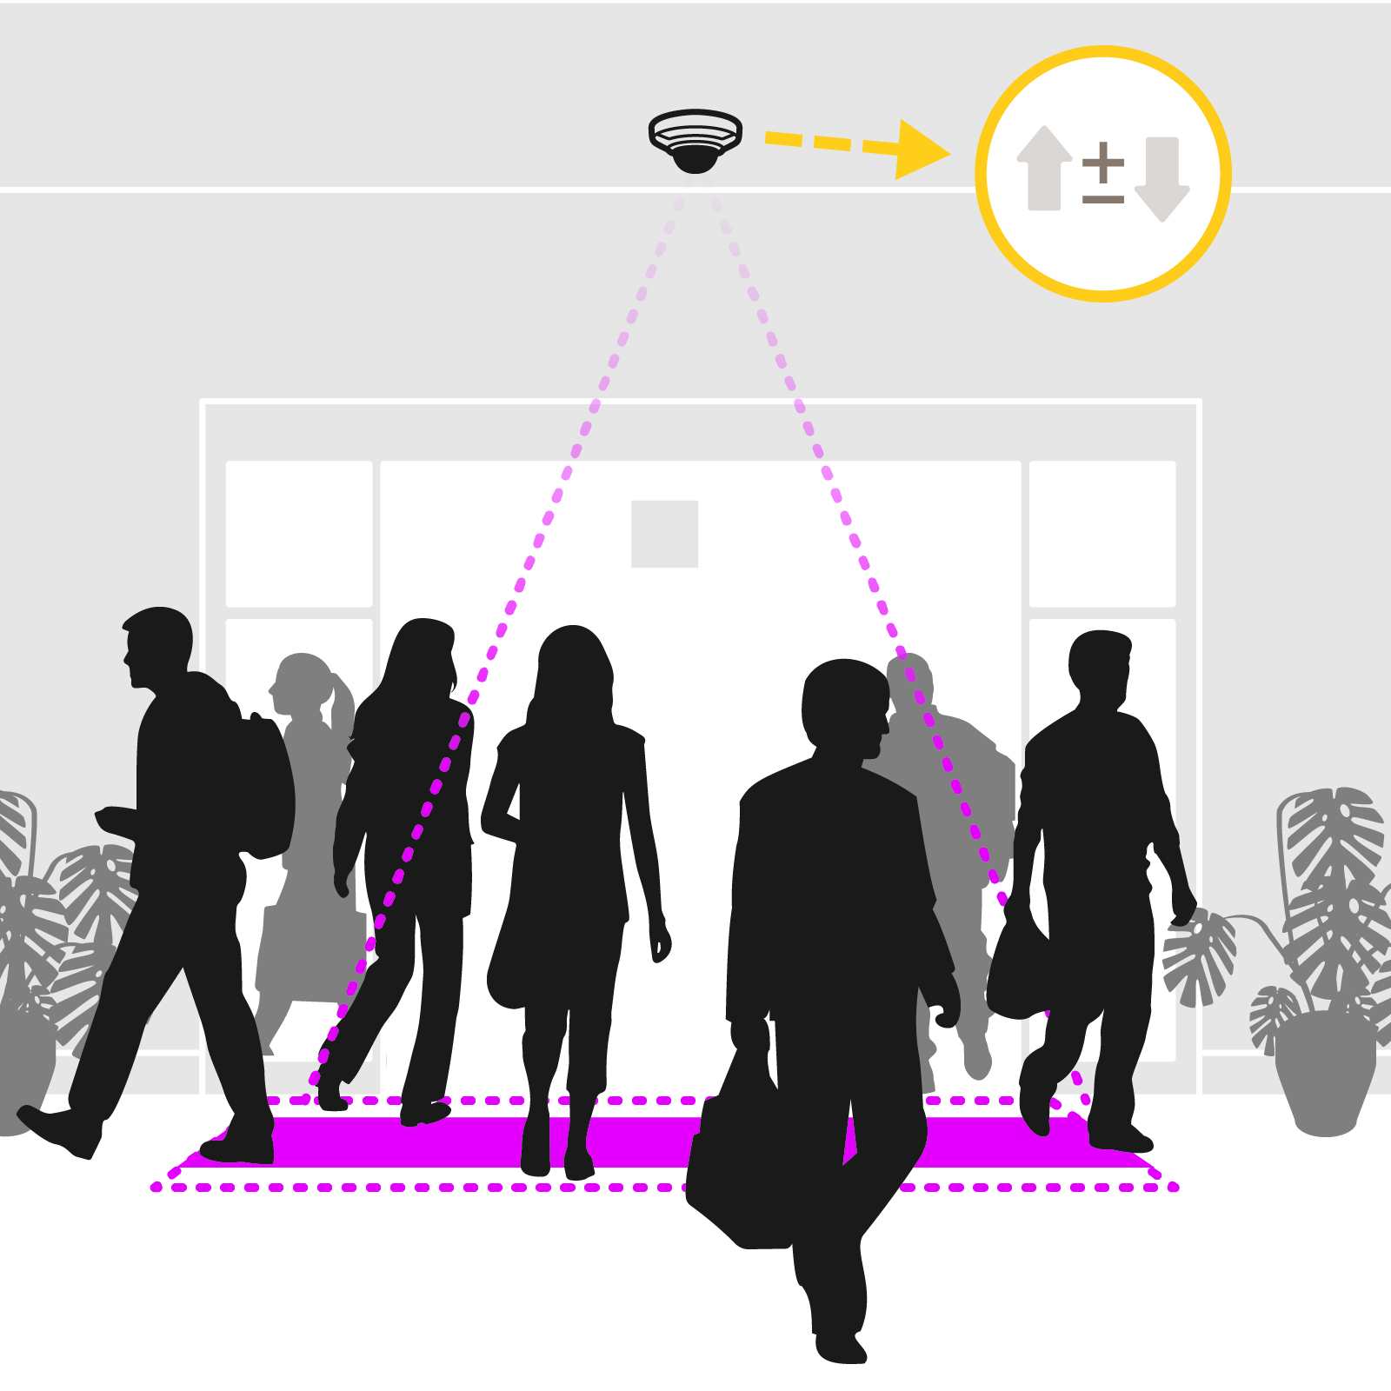
METHODOLOGY
Works on Infra-red sensor and Face Detection.
Infrared (IR) sensor is an electronic device used to measure and detect if an object is in front of it or not.
We used two infra-red sensor
Namely sensor A and sensor B
If a person goes from sensor A to sensor B ->
Entering the room.
If a person goes from sensor B to sensor A ->
Leaving the room.

Slide 7
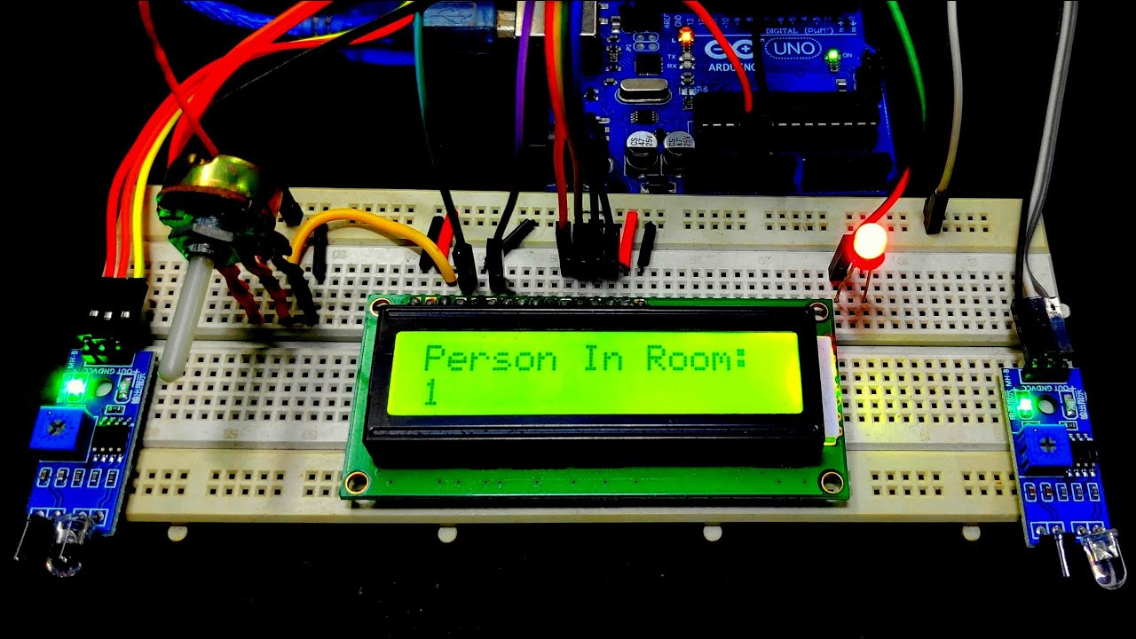
METHODOLOGY
And the multiple people entering at the same time problem is sloved by camera (face detection system) which will detect the number of faces according to its code and will count it .
At the end maximum of face detection system
and IR sensor will be counted and will be
added/subtracted from the number of persons
in that room.
And at last entering/exiting and capacity of the
room will be displayed on the LCD display.

Slide 8


OUR EFFORTS TO ADD TO THE TECHNOLOGY
444
We combined the face detection and IR sensor technology to solve multiple person at one time problem

Slide 9
PROBLEMS YET TO BE SLOVED
1
IR sensor is TEMPERATURE SENSITIVE
2
IR sensor RANGE IS 80 CM
3
ENTER AND EXIT AT SAME TIME

Slide 10




OUR TEAM
SUMIT SONI
RAJU KUMAR
PRAKHAR PRAYAS NAHAK
YASH RAJ

Slide 11

THANK YOU !!

